Slide 1

Fungicides and Management Implications for Boxwood Health
Jim LaMondia
The Connecticut Agricultural Experiment Station

Slide 2
Fungicides as management tools:
Which ones are effective?
How to use specific fungicides
Timing – when to use them

Slide 3
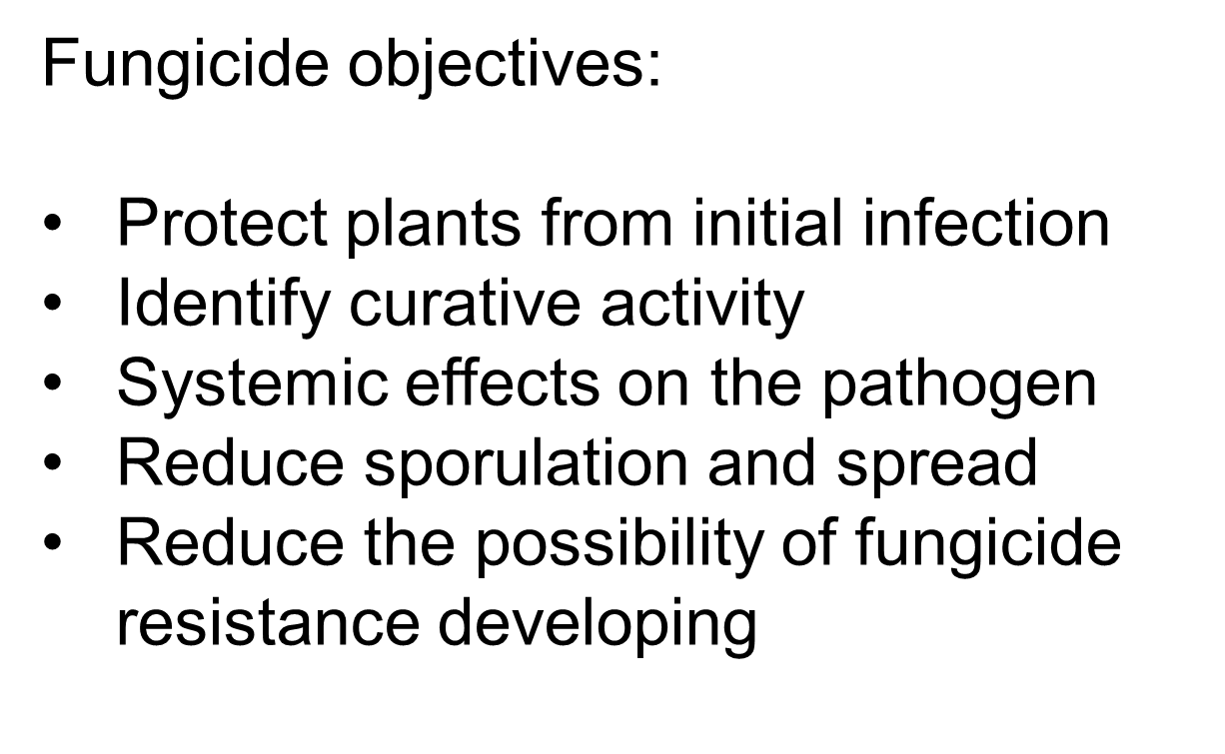

Slide 4
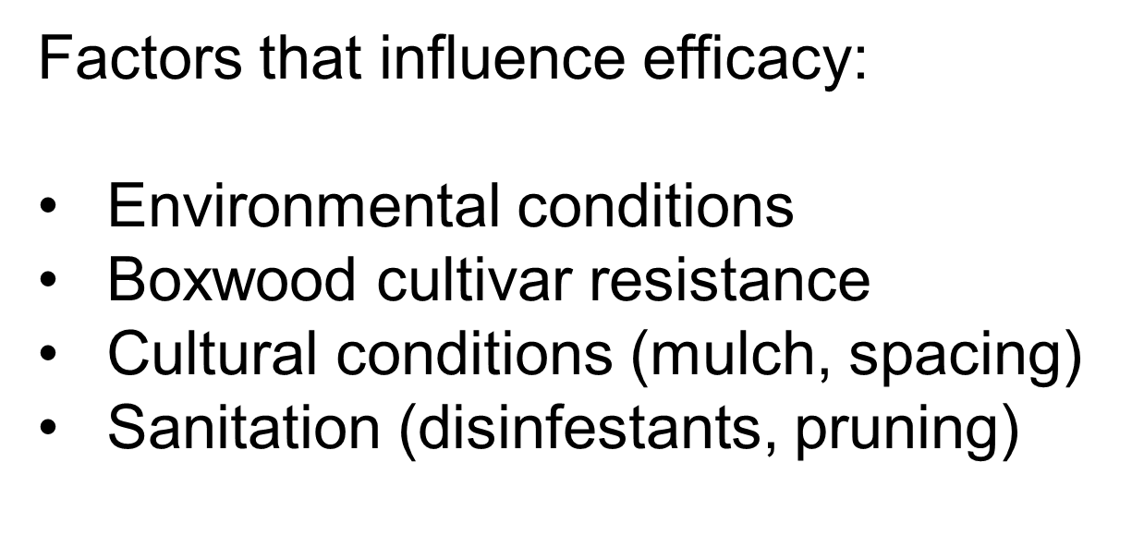

Slide 5
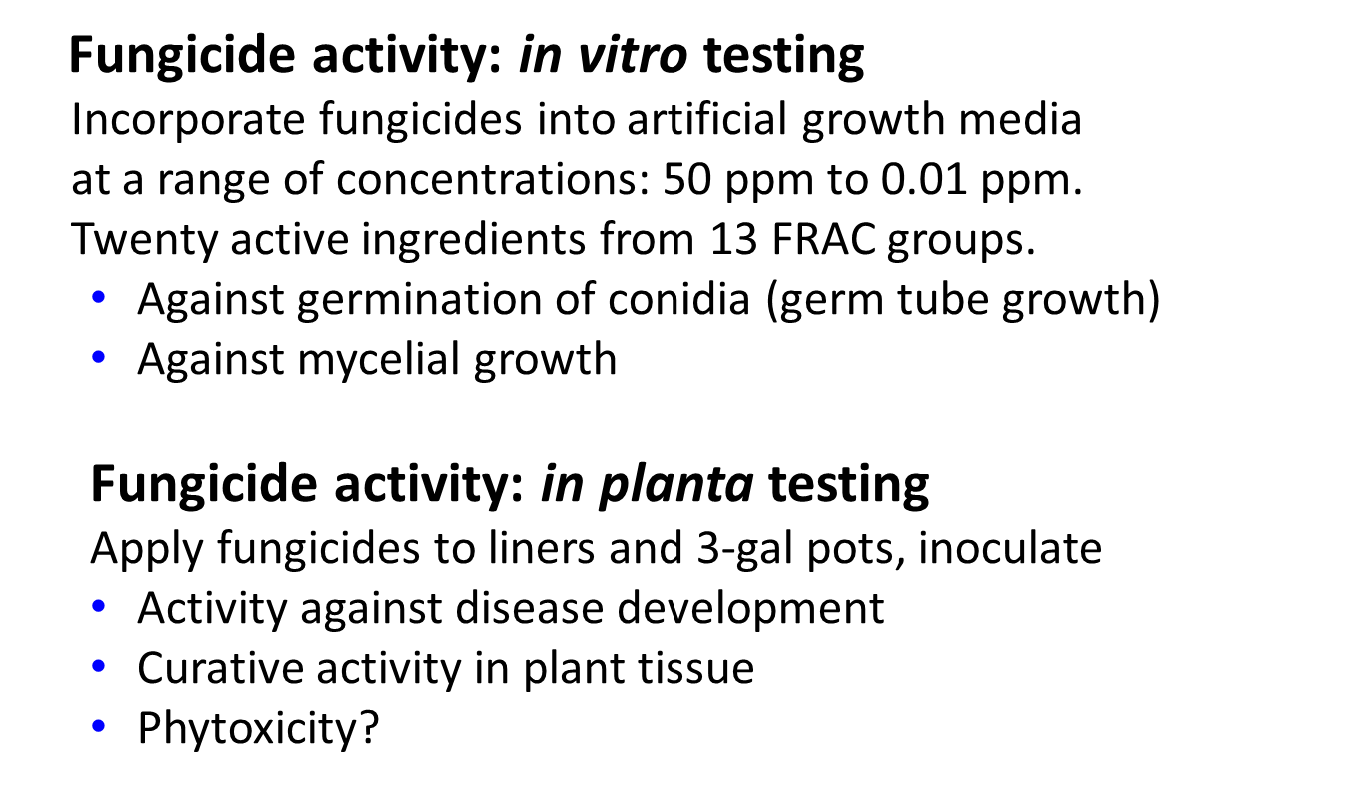

Slide 6
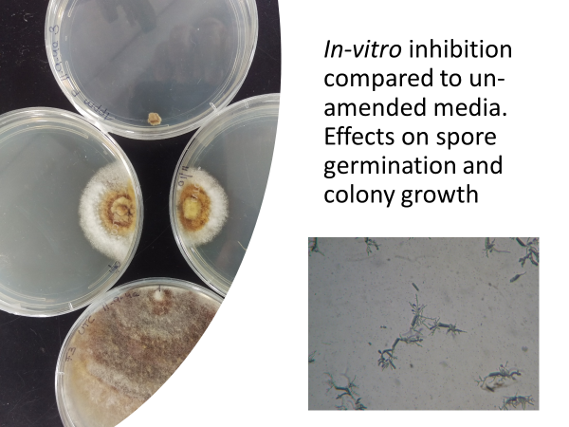

Slide 7
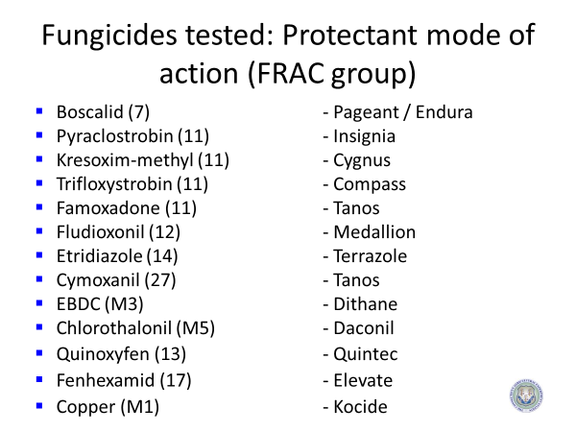

Slide 8
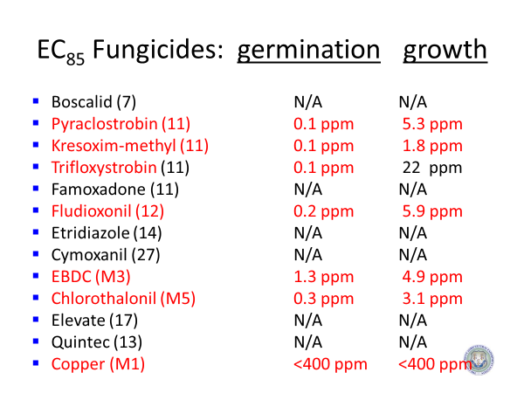

Slide 9
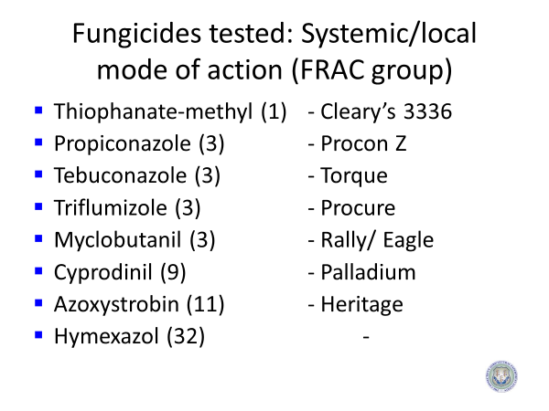

Slide 10
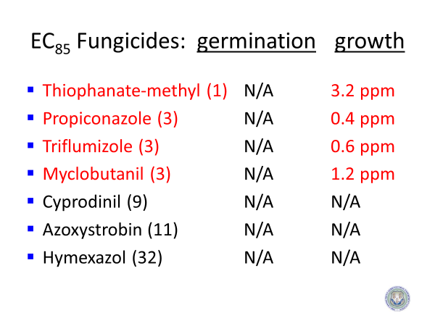

Slide 11
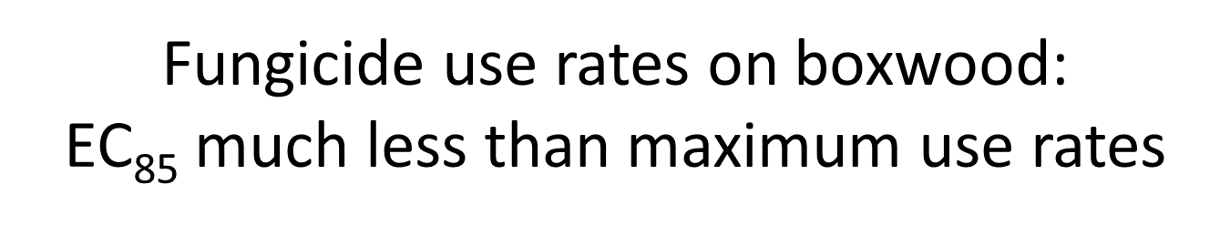
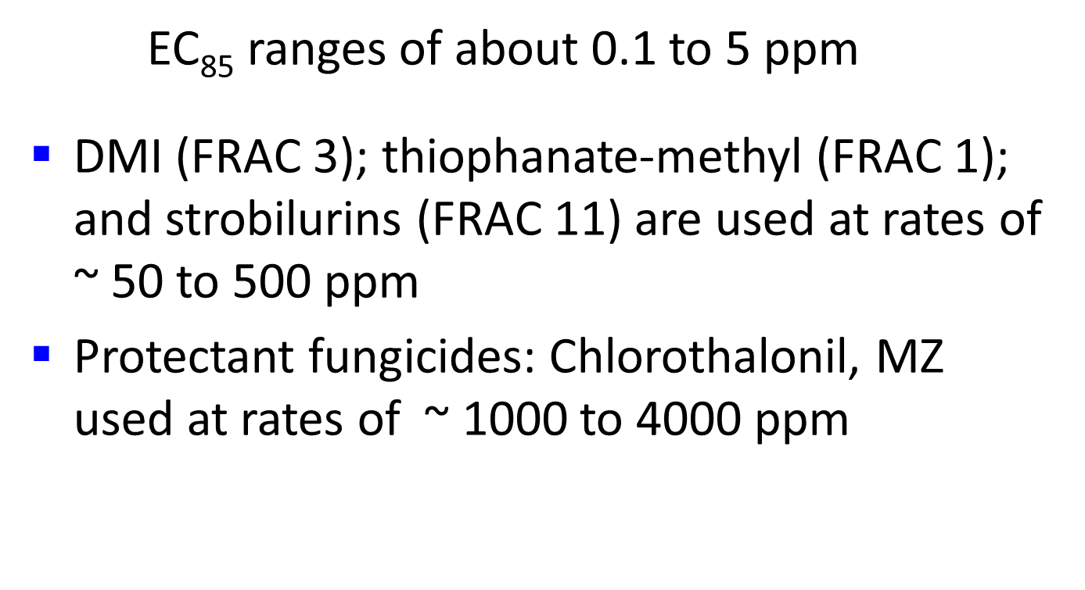

Slide 12
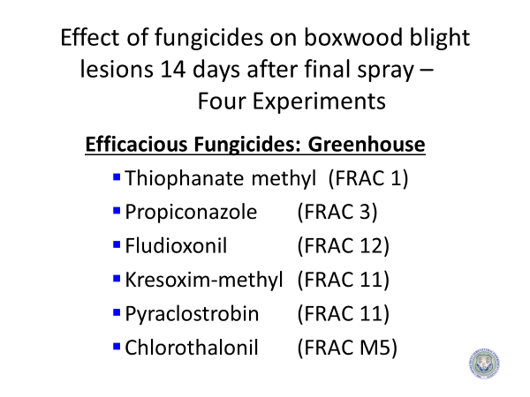

Slide 13
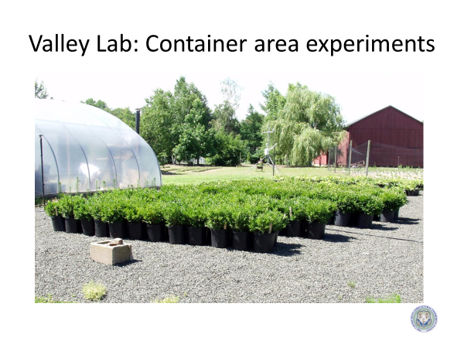

Slide 14
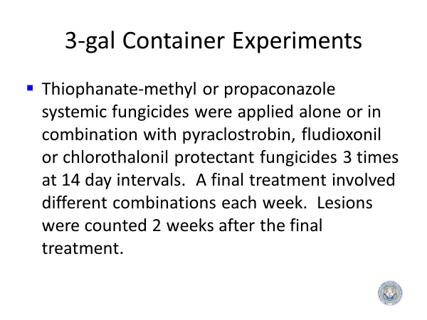

Slide 15
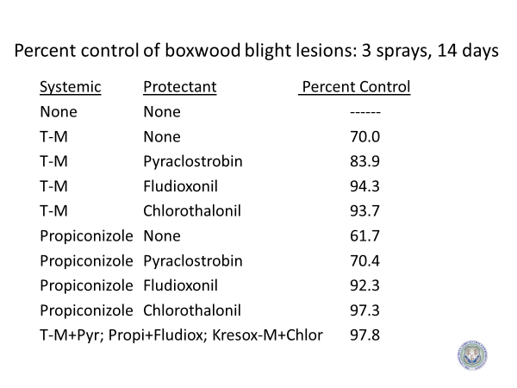

Slide 16
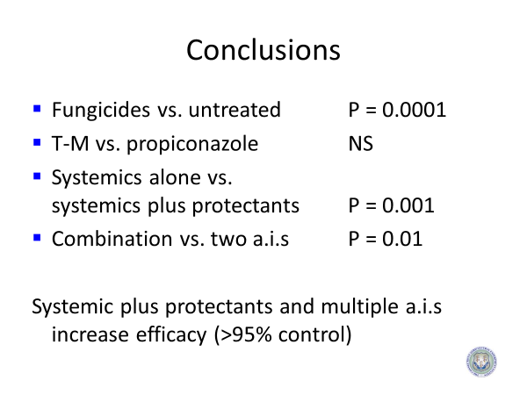

Slide 17
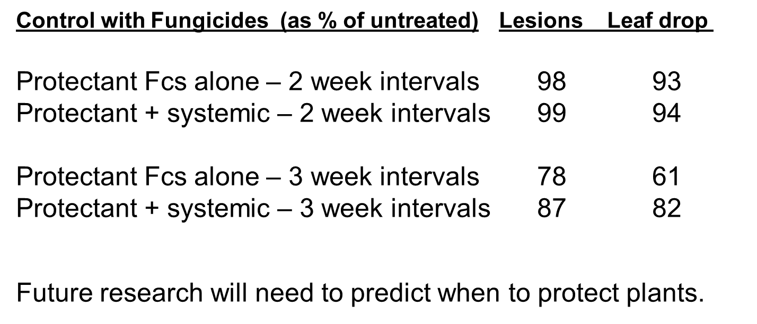

Slide 18
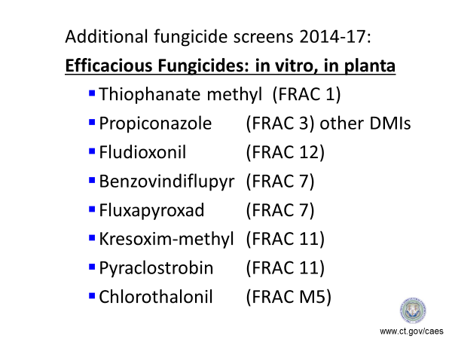

Slide 19
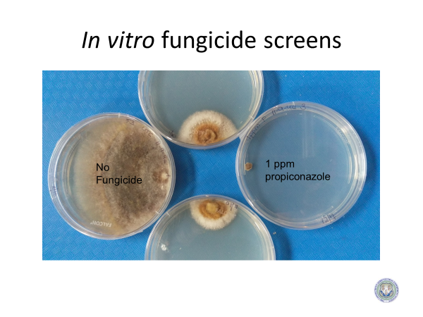

Slide 20
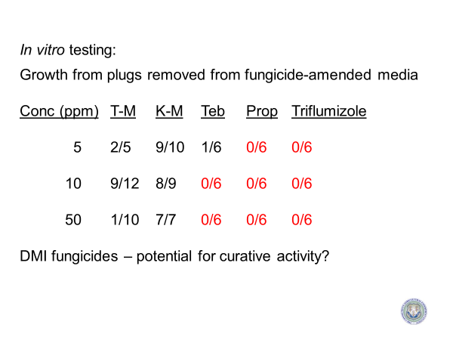

Slide 21
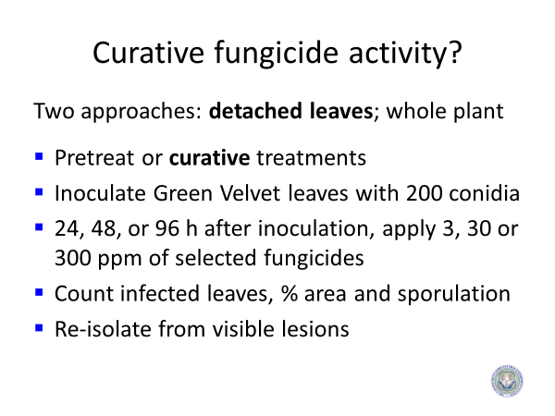

Slide 22
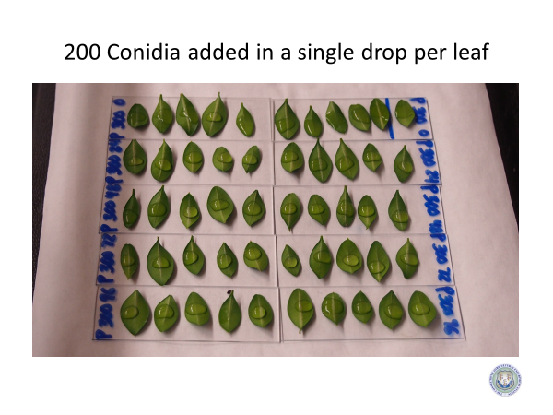

Slide 23
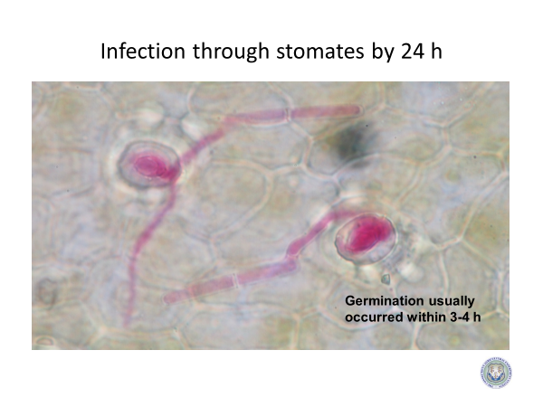

Slide 24
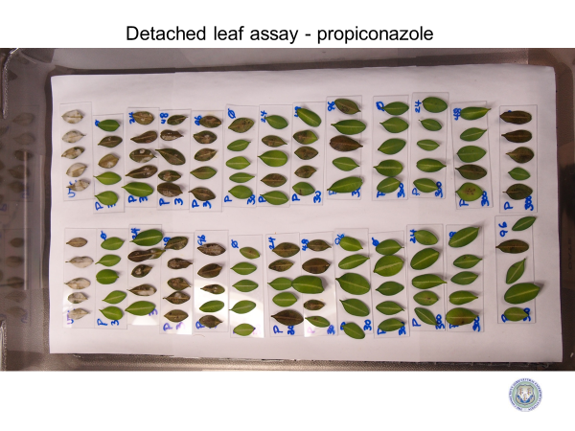

Slide 25
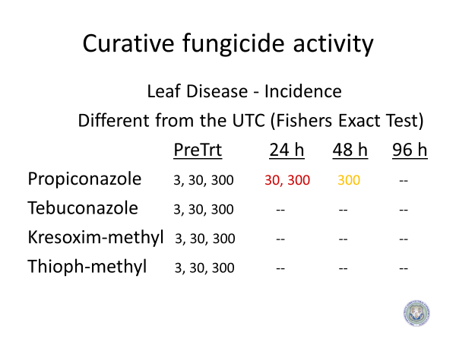

Slide 26
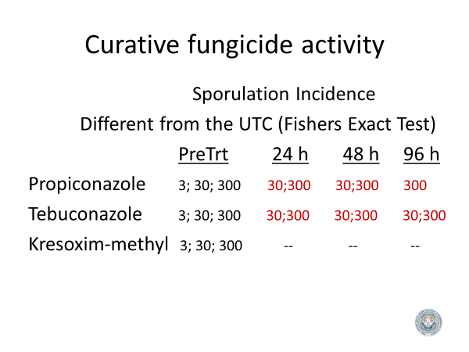

Slide 27
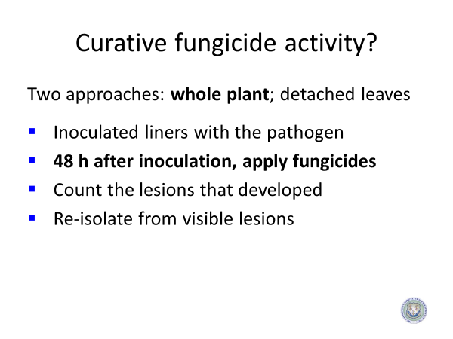

Slide 28
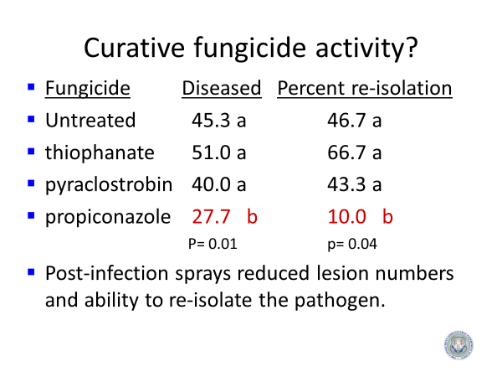

Slide 29
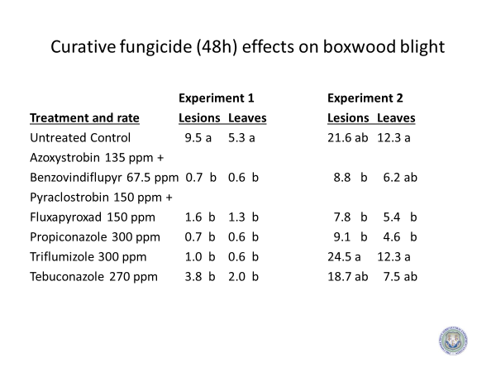

Slide 30
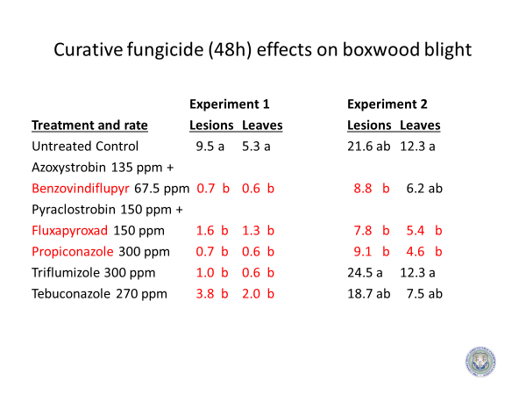
Experiment 2: increased disease severity

Slide 31
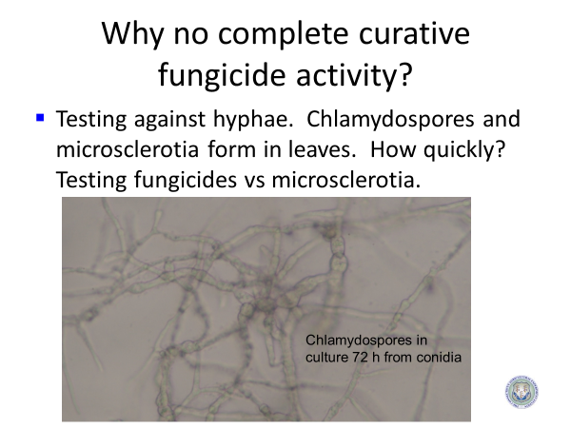

Slide 32
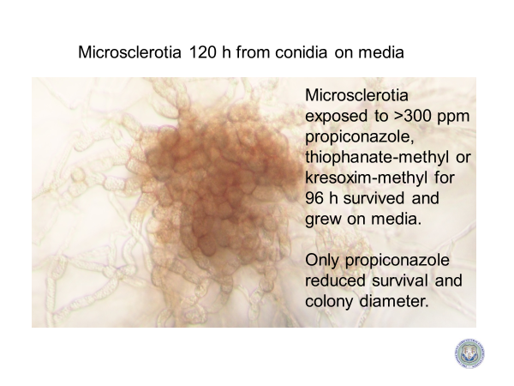

Slide 33
Survival of Cps MS after exposure to propiconazole
Less than 10% survival: required 72 hrs in 30 to 100 ppm fungicide
100% kill: only after 72 hrs at over 300 ppm
Fungicides not effective vs microsclerotia

Slide 34
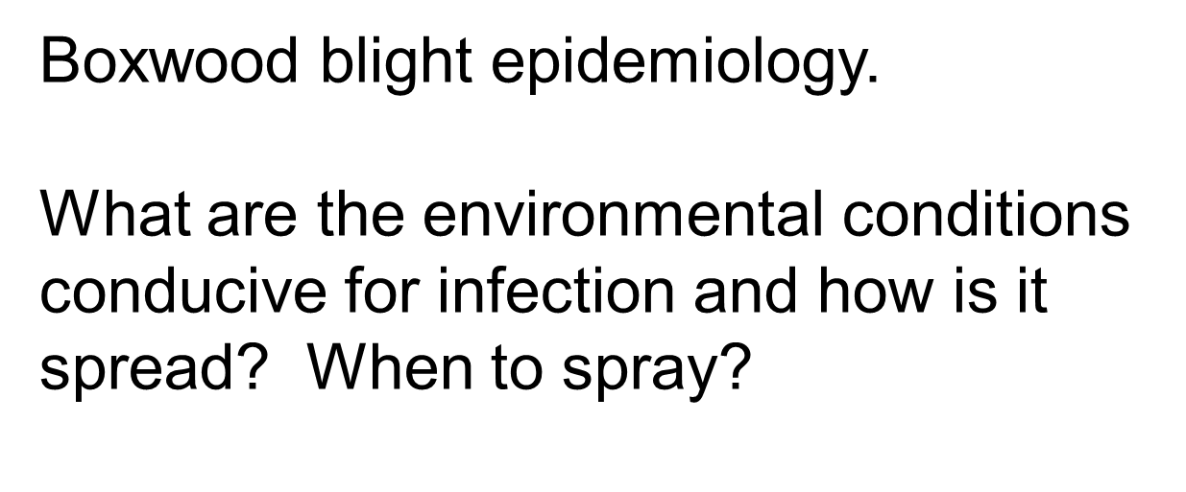

Slide 35
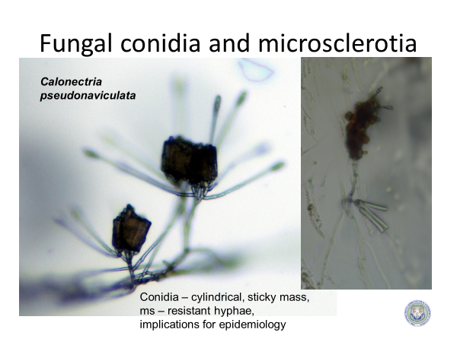

Slide 36
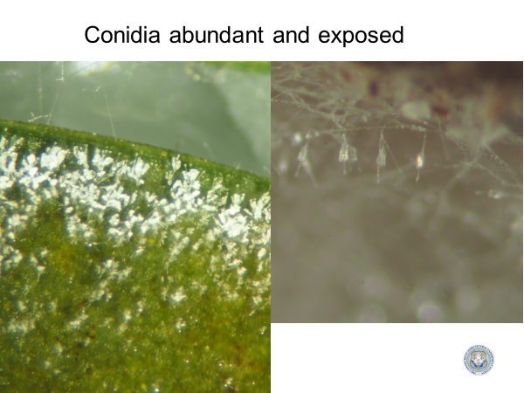

Slide 37

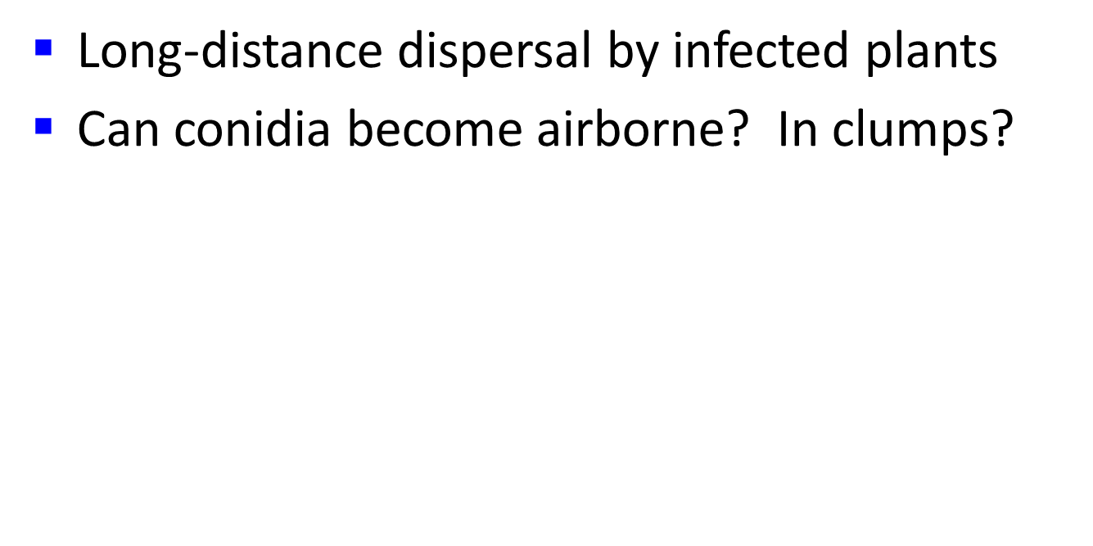

Slide 38
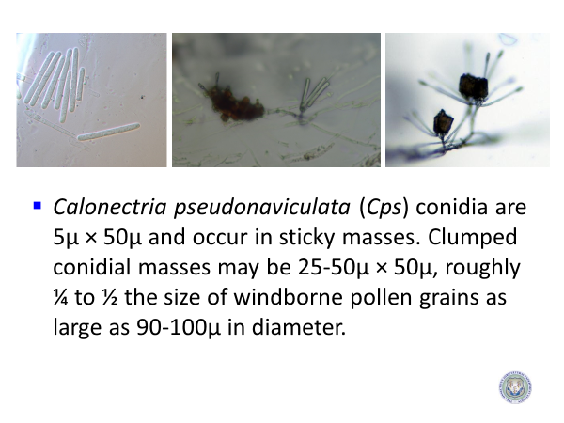

Slide 39
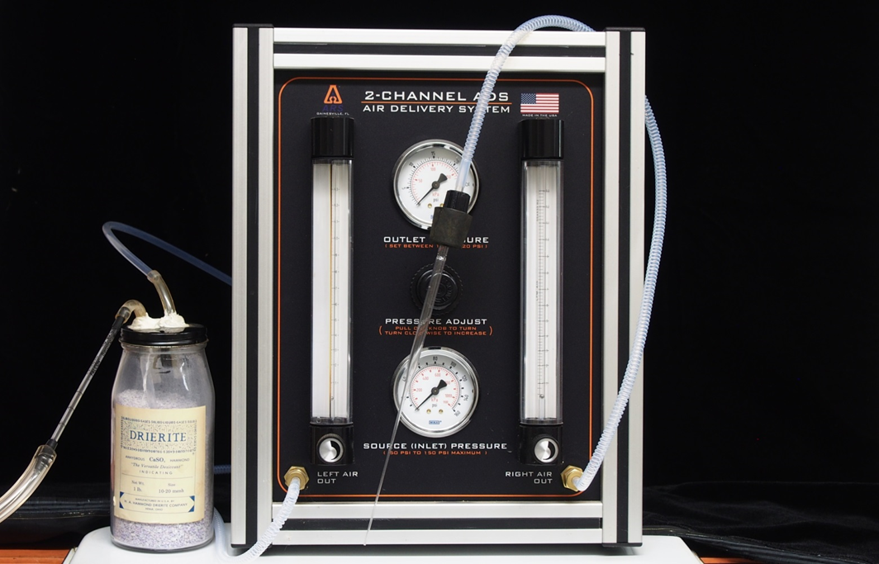
Dry or moist air currents of 44 mph for 10 min

Slide 40
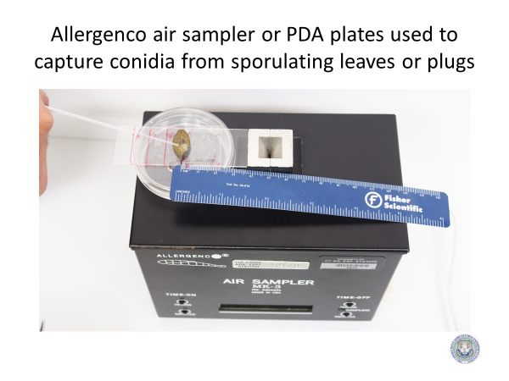


Slide 41
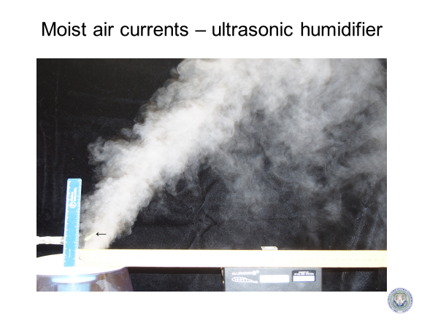

Slide 42
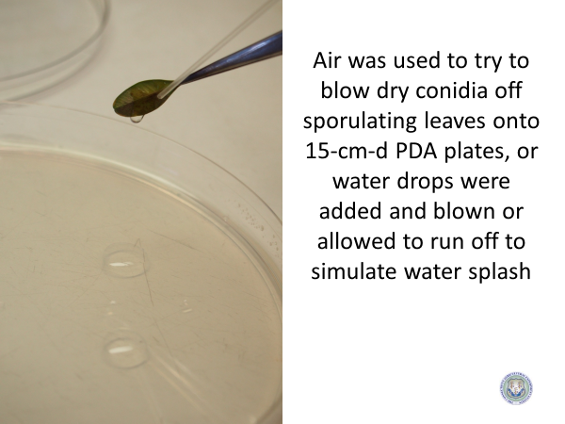

Slide 43
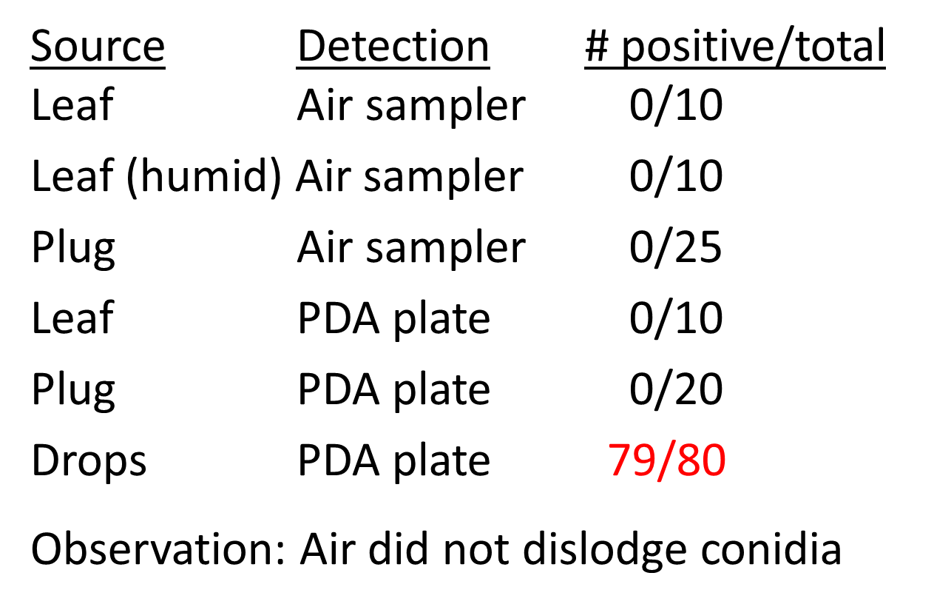

Slide 44

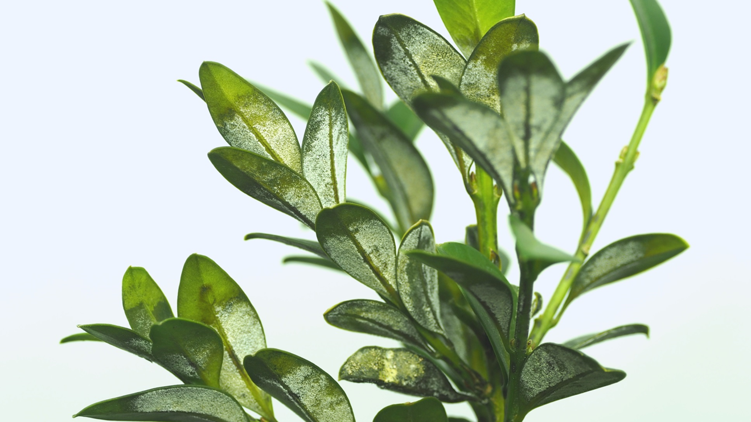
Water splash from under leaves?

Slide 45

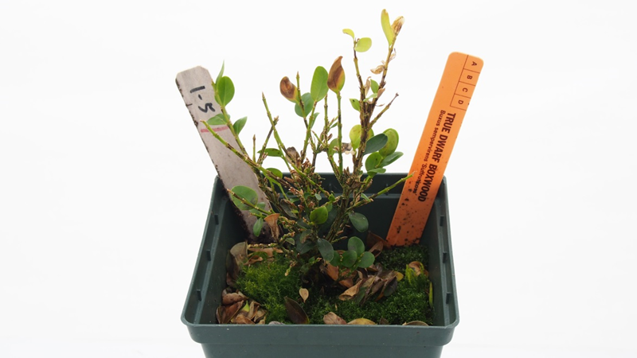
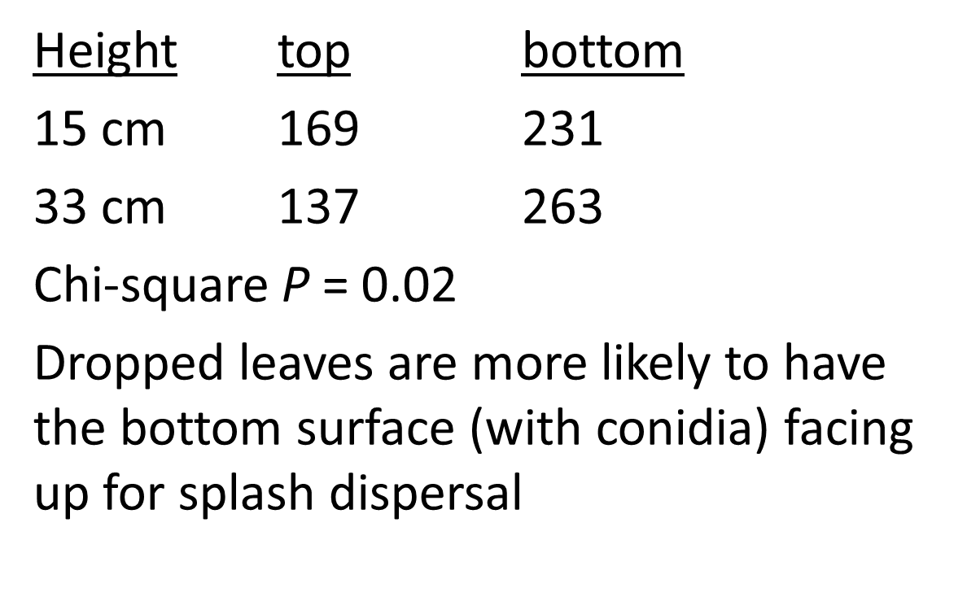

Slide 46
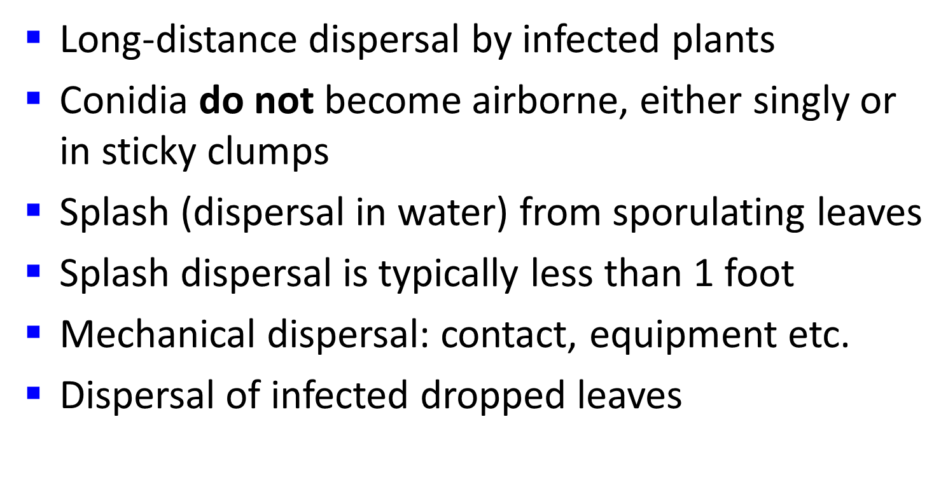

Slide 47
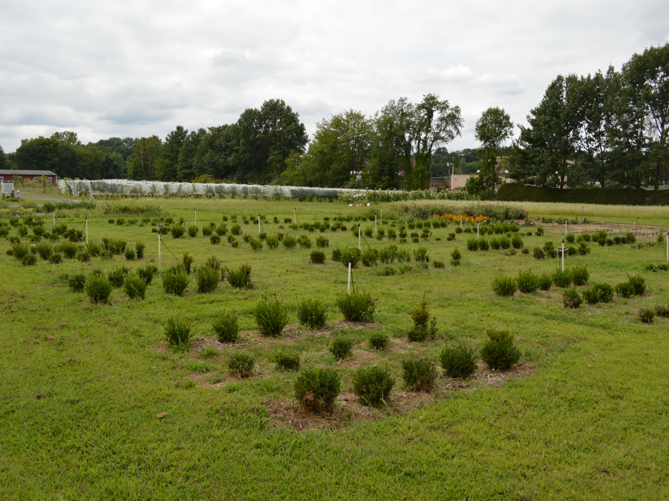
Experiment:
Fungicide and
cultivar effects
on spread

Slide 48
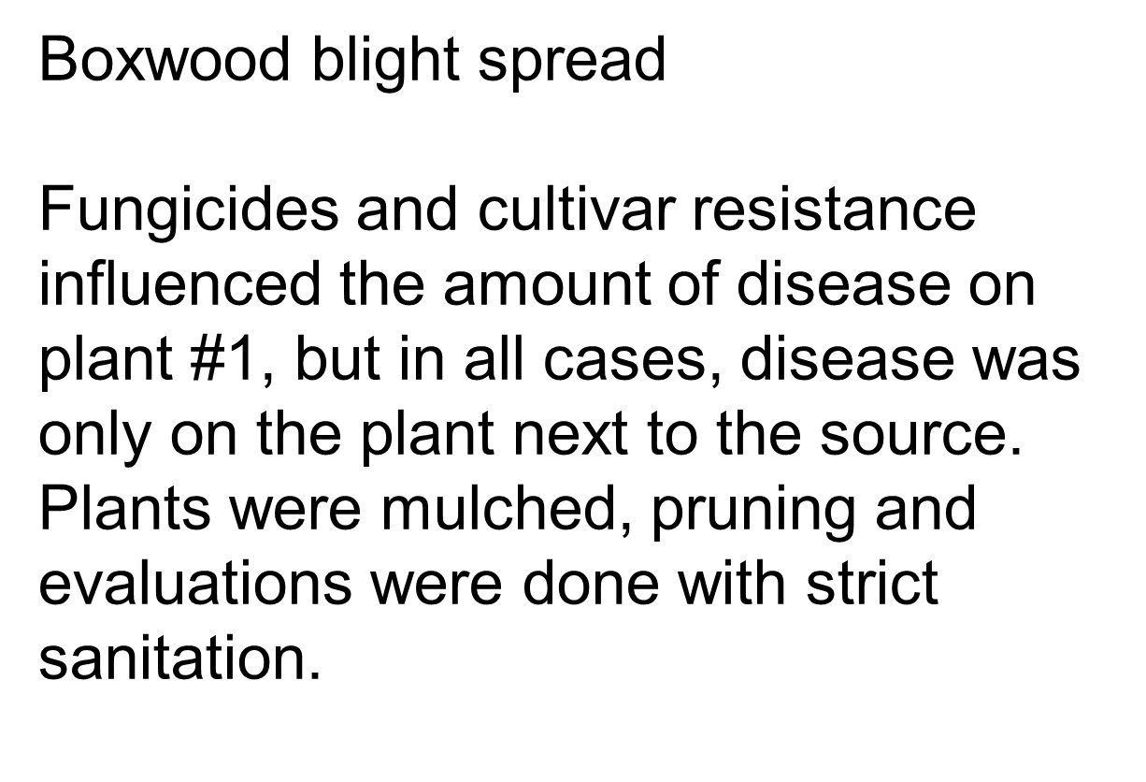

Slide 49
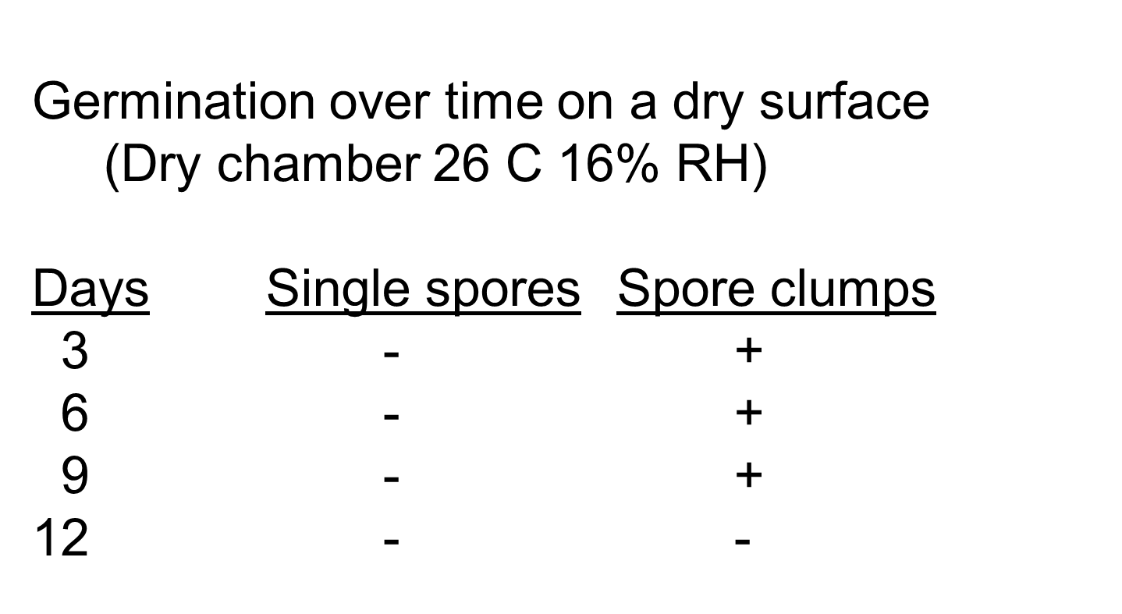

Slide 50

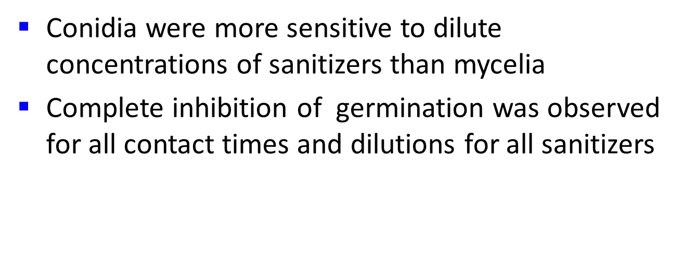
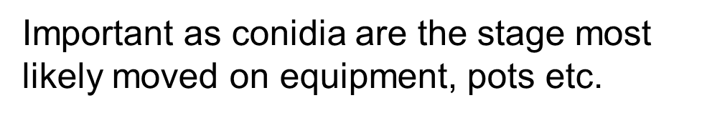

Slide 51


Slide 52


Slide 53



Slide 54


Winter Gem incidence lower,
lesions smaller, fewer spores

Slide 55


Slide 56
Plant resistance is often the most effective
disease control.
Buxus spp. and cultivars differ in susceptibility.
Integrate fungicides with resistance and BMPs.

Slide 57


Slide 58


Slide 59


Slide 60


Slide 61


Slide 62



Questions?
This material is based upon work that is supported by the National Institute of Food and Agriculture, U.S. Department of Agriculture, under award number 2020-51181-32135.

Slide 63

We Want Your Feedback!
or scan the QR code as you exit this session:
1) Open the camera app on your mobile device
2) Point the camera at the QR Code on the sign by the door
3) Tap the web link and evaluate
Evaluation Address:
cultivate.cnf.io

